Slide 1
Disabled Access
The Americans with Disabilities Act is based on the principle that disabled access is a civil right similar to rights based on race and gender.

Slide 2
Disabled Access
Who benefits:
Wheelchair users
Ambulatory mobility impairments
Visual impairments
Hearing impairments
Other disabilities
Temporary disabilities
Parents with infants

Slide 3
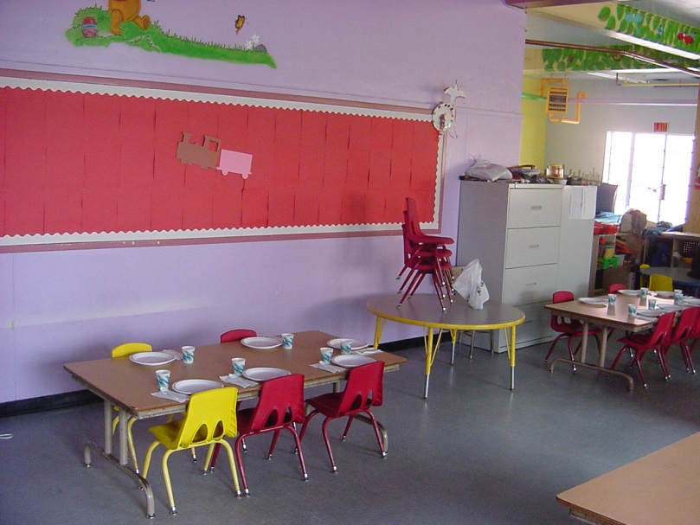
Alterations
Where existing buildings are altered, each altered element or space shall comply with disabled access requirements of San Francisco Building Code and the Americans with Disabilities Act Standards – 2010 except where it is technically infeasible.
Zachary Nathan Architect, AIA, CASp

Slide 4
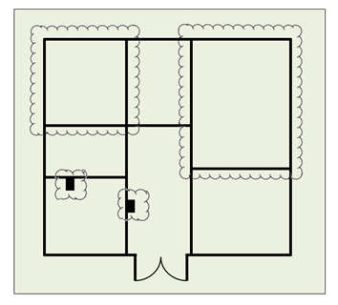
Alterations
Standards apply to those elements and spaces that are altered.
Zachary Nathan Architect, AIA, CASp

Slide 5
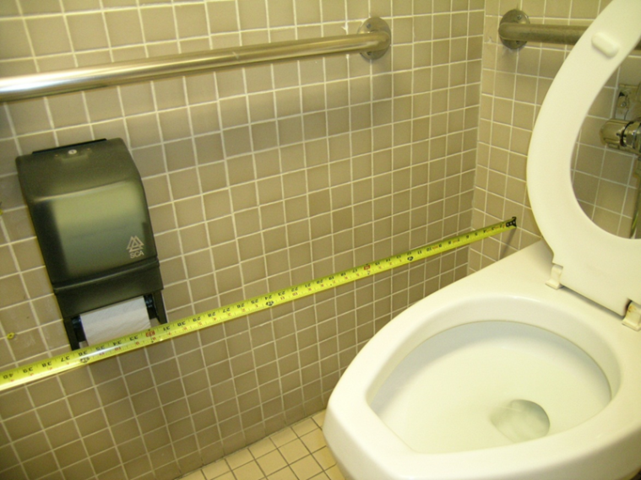
Path of Travel
Where alterations are made to a building, an accessible path of travel shall be provided including:
1) A primary entrance
2) Toilet and bathing facilities serving the area
3) Drinking fountains serving the area
4) Public telephones serving the area
5) Signs
6) Parking, storage, etc. serving the area
Zachary Nathan Architect, AIA, CASp

Slide 6
Path of Travel
Exceptions:
1) if previously altered and in compliance with preceding edition of building code (2010)
2) work limited to barrier removal only
3) Below threshold - $143,303 (2014) – limited to 20% of construction cost
4) Above threshold - equivalent facilitation or Unreasonable hardship with access to the greatest extent possible with a minimum 20% of construction cost for compliance.
5) Elevator exception – 20% disproportionality
Zachary Nathan Architect, AIA, CASp

Slide 7
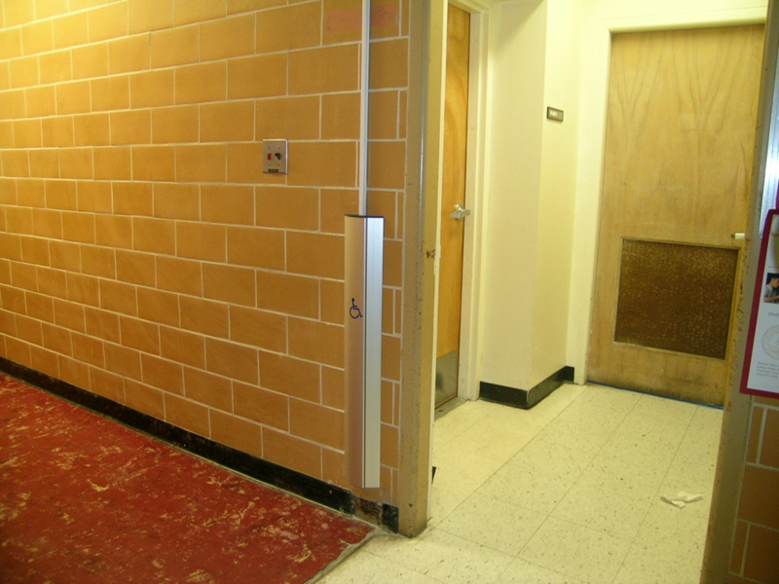
Equivalent Facilitation
An alternative means of complying with the literal requirements that provides access in terms of the purpose of the building code.
Zachary Nathan Architect, AIA, CASp

Slide 8
Unreasonable Hardship
1) Cost of Providing Access
2) Cost of Construction
3) The impact of proposed improvements on financial feasibility of the project
4) The nature of the accessibility which would be gained or lost
5) The nature of the use of the facility under construction and its availability to persons with disabilities
All Unreasonable Hardships require Access Appeals Commission Approval
Zachary Nathan Architect, AIA, CASp

Slide 9
Technical Infeasibility
1) An alteration that has little likelihood of being accomplished because the existing structural conditions require the removal or alteration of a load bearing member that is an essential part of the structural frame or….
Zachary Nathan Architect, AIA, CASp

Slide 10
Technical Infeasibility
2) An alteration that has little likelihood of being accomplished because the existing physical or site constraints prohibit modification or addition of elements, spaces or features which are in full and strict compliance with the minimum requirements for new construction.
Zachary Nathan Architect, AIA, CASp

Slide 11
Technical Infeasibility
Where enforcing authority determines compliance is technically infeasible, an alteration shall provide equivalent facilitation or comply with the requirements to the maximum extent feasible.
Zachary Nathan Architect, AIA, CASp

Slide 12
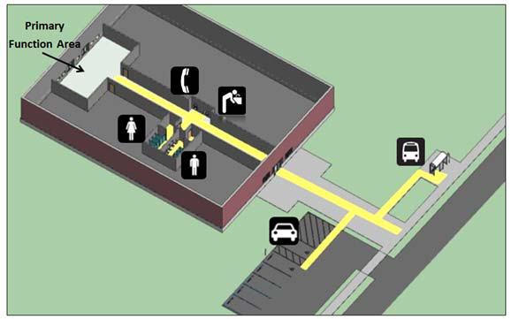
Example 1
Path of Travel
Zachary Nathan Architect, AIA, CASp

Slide 13
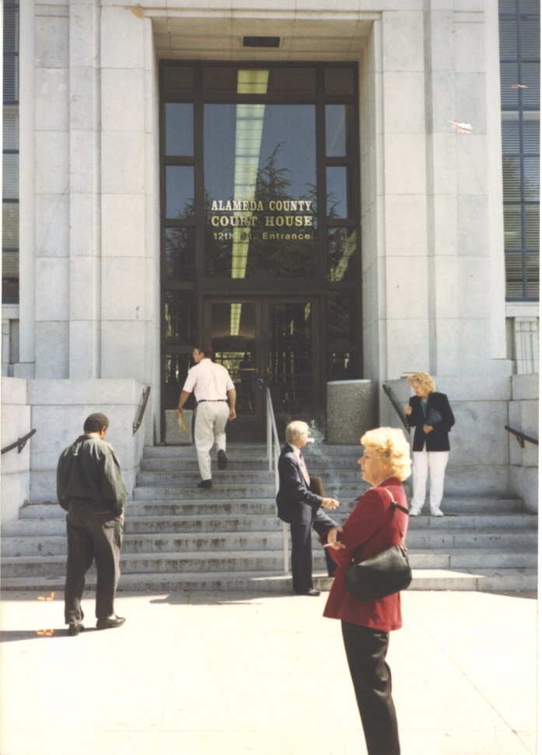
Example 2
Stairs at entrance
After
Before
Zachary Nathan Architect, AIA, CASp

Slide 14
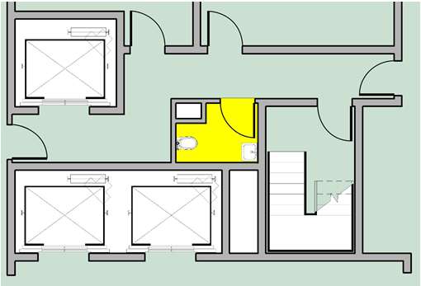
Example 3
Technical infeasibility
Zachary Nathan Architect, AIA, CASp

Slide 15
What is a CASp?
The California Division of the State Architect certifies specially trained experts in disability access requirements known as Certified Access Specialists or CASp
Most CASps are building inspectors, architects, contractors, engineers and people with extensive backgrounds in accessibility issues.
Must meet minimum qualifications
Pass a multiple choice test about codes and standards, access issues, plan review and field issues.
Continuing education requirement.
Not all CASps do surveys
Zachary Nathan Architect, AIA, CASp

